Slide 1
Portfolio presentation
Slide deck
Matthew Liu, 20/04/21

Slide 2
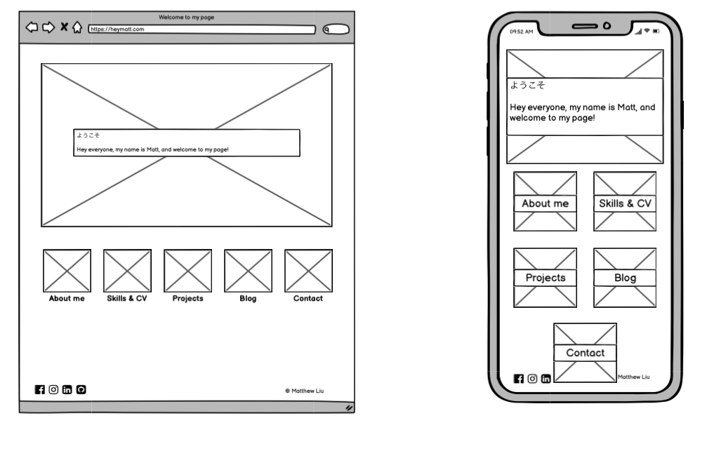
Planning
Initial thoughts: minimal but easy to navigate
A few aesthetic choices I wanted in home page of portfolio:
Using a href on an image to get to a child page
Considered the use of hover attribute on the image elements for desktop to make it more engaging for user (see arrow)
Colour scheme: kept to a minimum
Text over main imagery, with low opacity to still allow for see through image
Apply responsive design and flexbox for mobile viewing, contained between two columns
Social media icons below (bottom right) also to use image href to connect to profiles

Slide 3
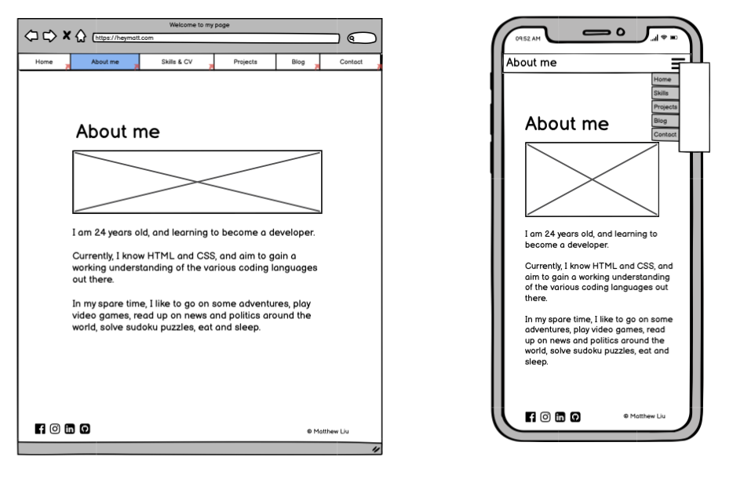
Planning
Initial planning the child pages
Fixed navigation bar at top of the page (for both desktop and mobile)
Dropdown menu for mobile
Use of imagery as a way to catch users attention

Slide 4
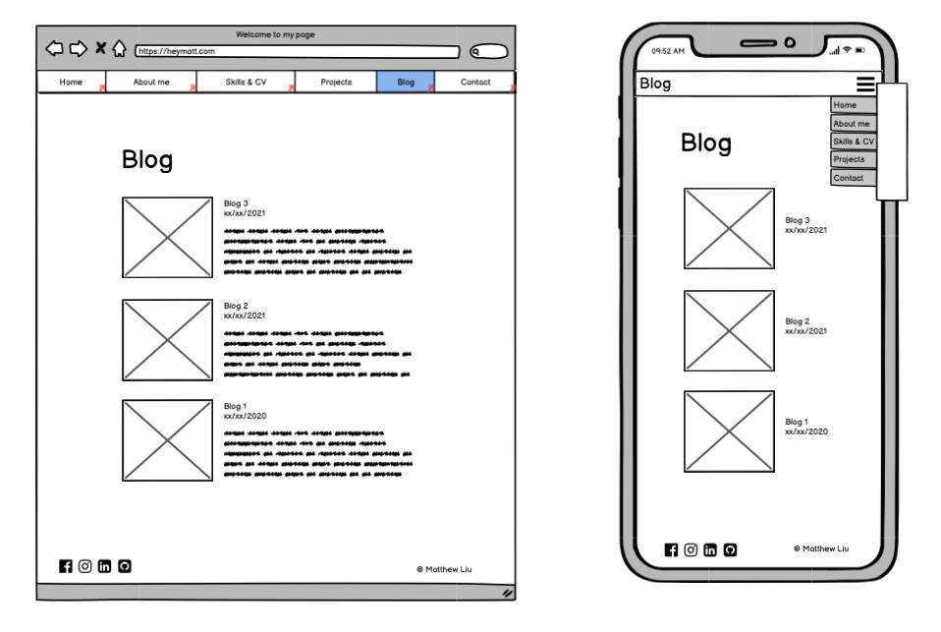
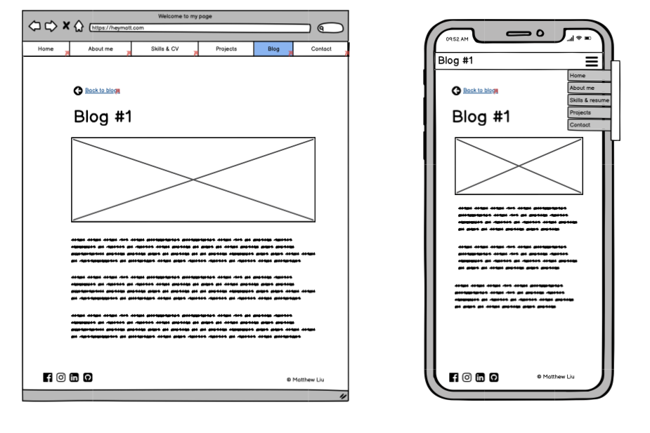
Planning
Blog page
Initial planning for blog page:
List of blogs, with image href and brief description
Image would lead into blog itself
Page transitions to blog page, without opening a new page
Button to go back to list, also without opening a new page
May involve some Javascript and possibly ruled out for now

Slide 5
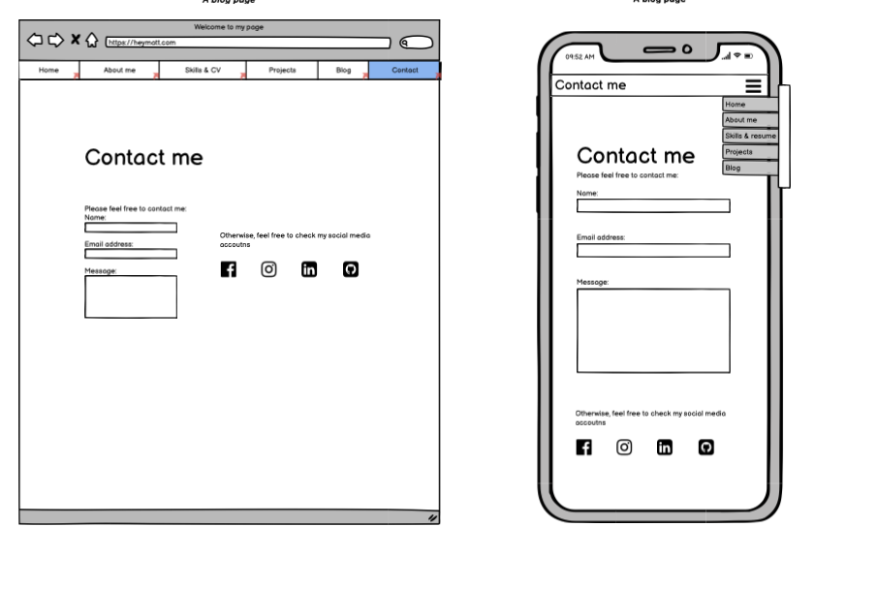
Planning
Contact page
Contact page
Create a form in HTML to contact
Also included links to social media

Slide 6
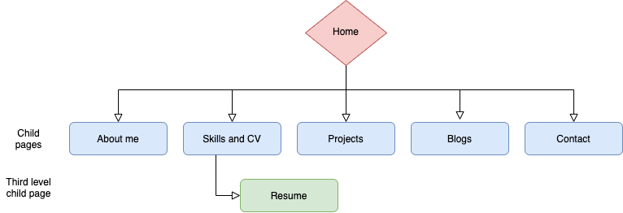
Planning: sitemap
Simple and easy to navigate
Child pages can be accessed via home page
Other pages can also be accessed via navigation bar
Resume can only be accessed via Skills and CV page
External links to social media accounts placed on footer

Slide 7
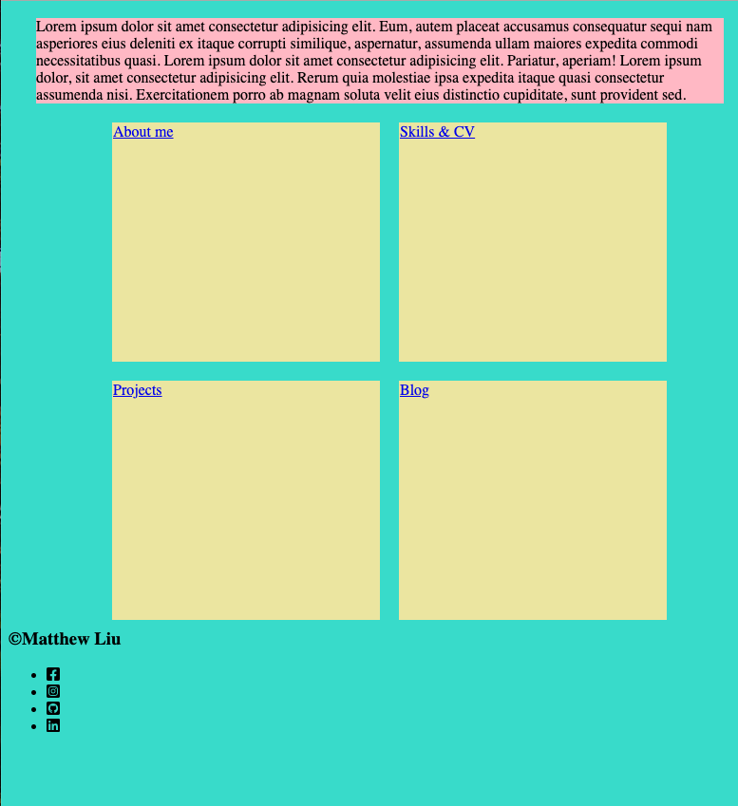
Testing layout
Initially used this html document as a test page
See what sort of layout I wanted for home page
Experimenting with flexbox and media queries to understand how they work
Testing out social media icons from Fonts Awesome

Slide 8
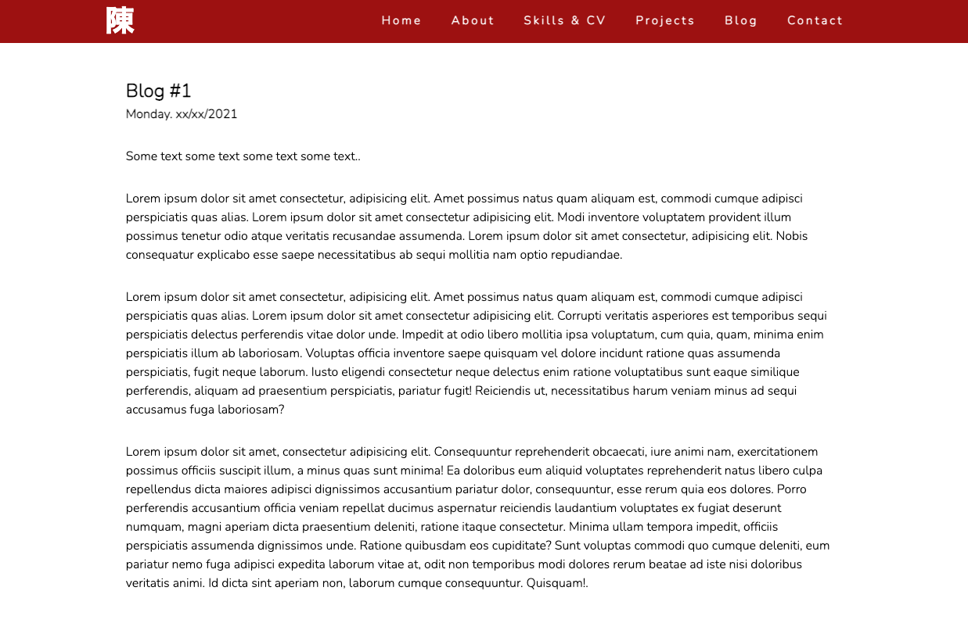
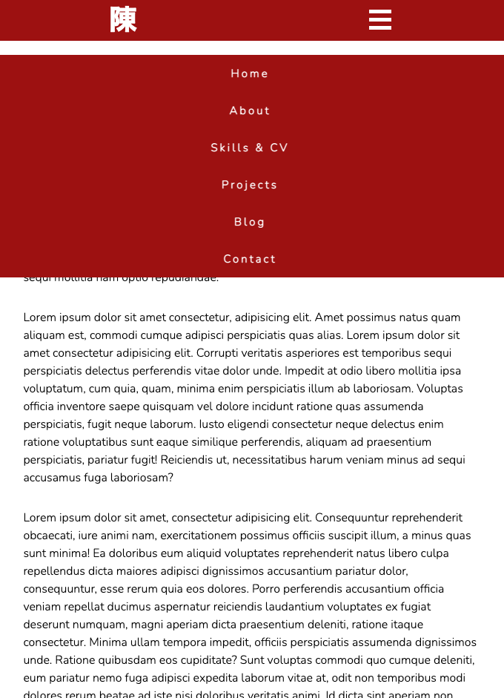
Testing layout
Testing layout of page
Layout of page
Experimented a bit with the margins for layout of page (first image)
Navigation bar
Changing width between menu items on navigation bar
Experimented with Javascript for dropdown menu
Specifically for mobile
Wanted to ensure position for both mobile and desktop were fixed and always showing
Navigation bar-mobile

Slide 9
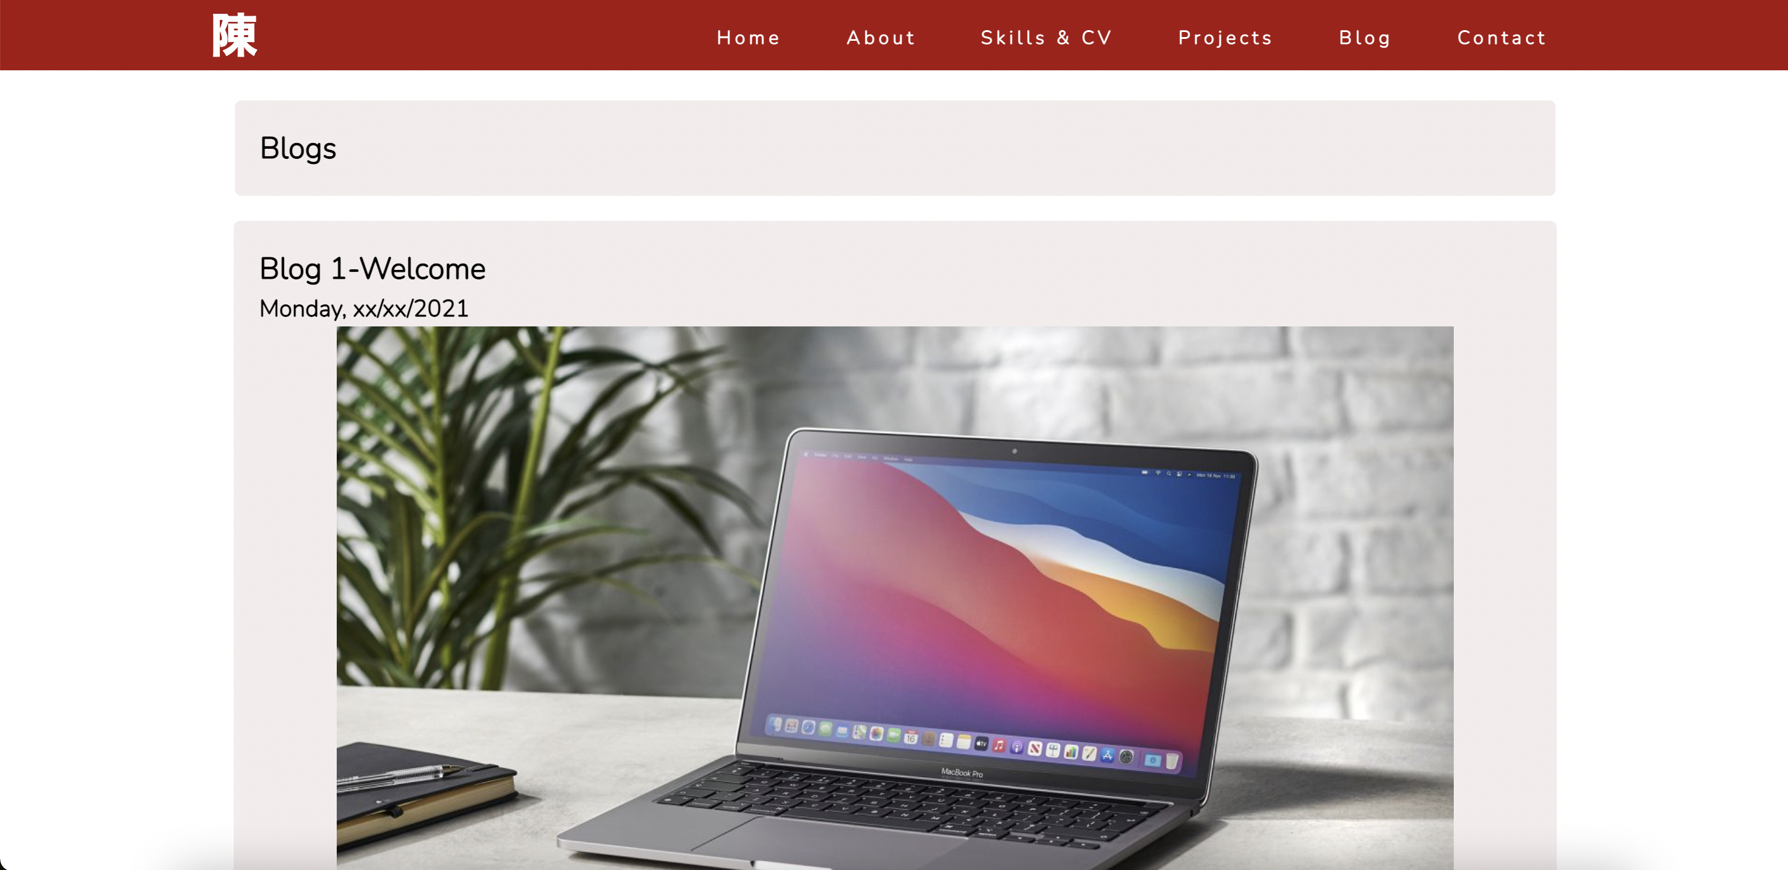
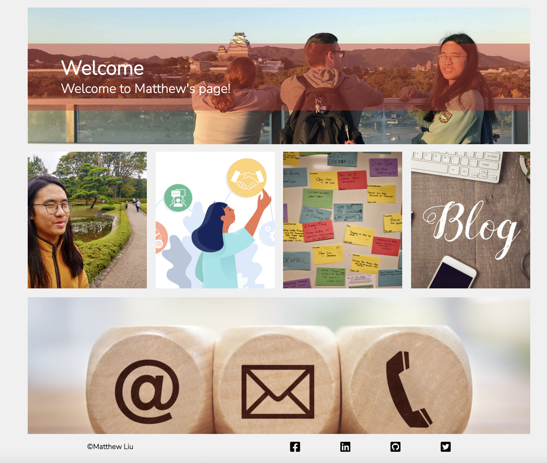
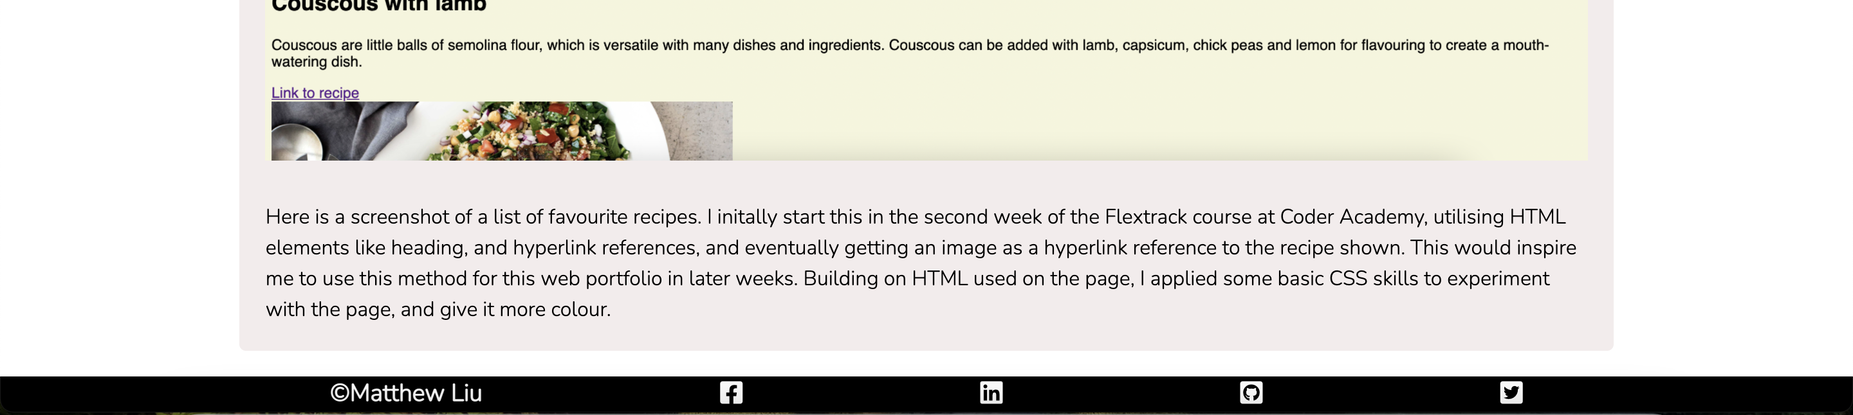
Previews
Blog page-desktop
Home page-desktop
Footer on each child page

Slide 10
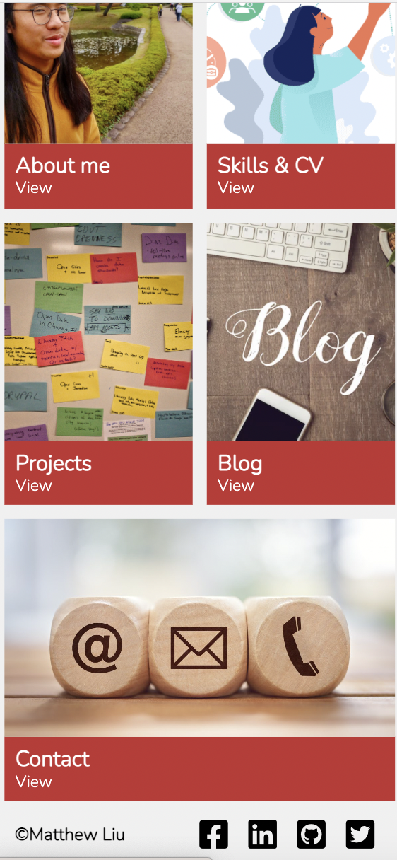
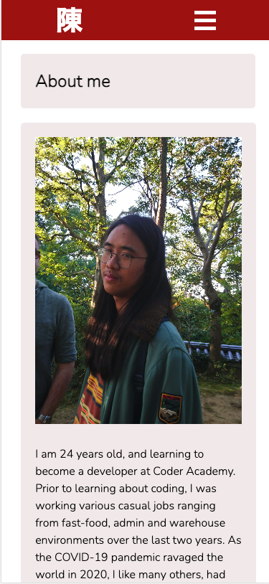
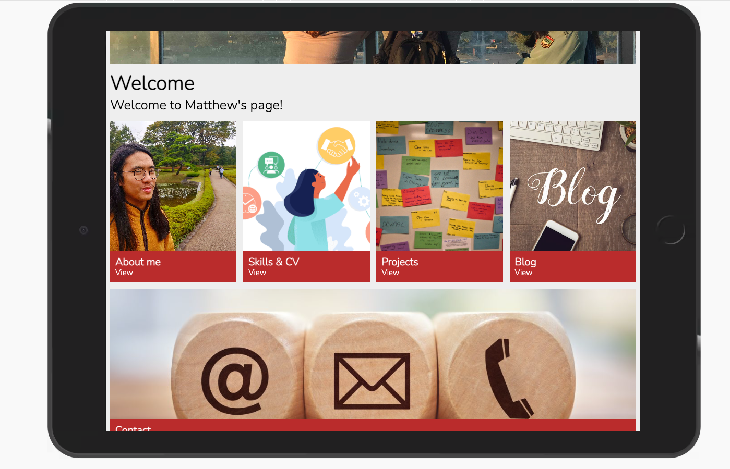
Previews
Home page-mobile
About me page-mobile
Home page-tablet

Slide 11
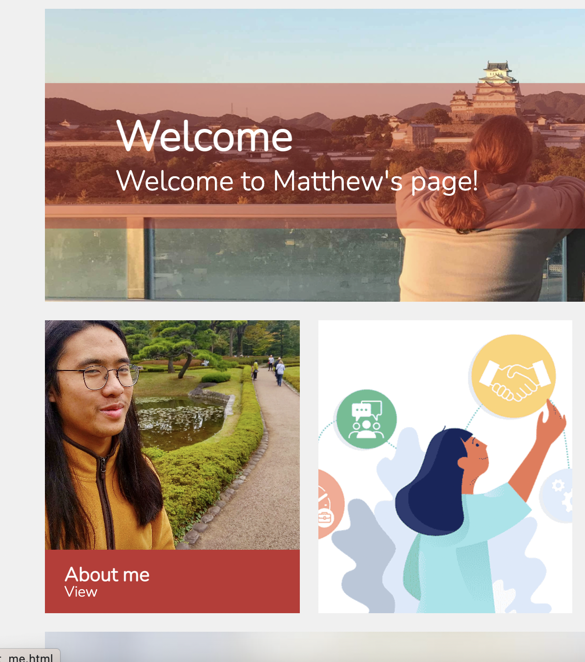
Features
Home page with hover-desktop
Home page
Use of hover and transform to reveal menu item for desktop
Feature disabled for smartphone and tablet
Use of text over main image, and opacity applied
Initially tried flexbox for home page
CSS grid applied as I felt it worked better with what I wanted, and allowed be to customise images size and how far I wanted it to spread on screen

Slide 12
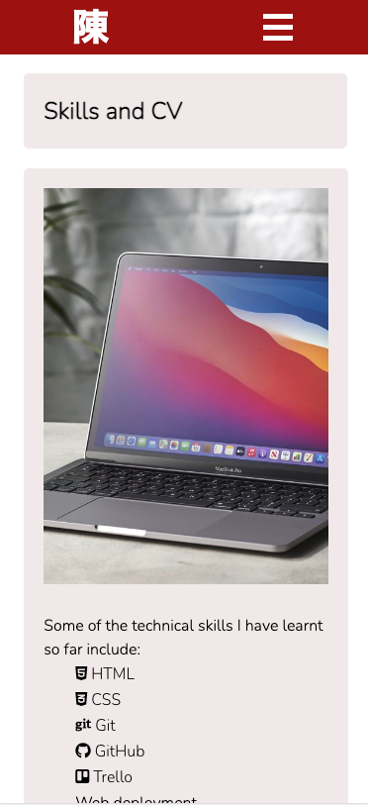
Features
Skills & CV page-mobile
About me page-mobile
Navigation bar
Applied Javascript for dropdown menu for mobile view
Use of text over image, and opacity applied
With mobile and tablet view, hover and transform feature disabled
Background colour for content
Used this feature as a way to draw people in

Slide 13
Review
Favourites bits
Whilst challenging, enjoyed creating the home page and making it come to life
Designing with CSS and Sass was also enjoyable
Challenges
Designing with CSS also challenging, especially when features don’t match up
Spent way too much time focused on page aesthetics
Javascript menu; spent all night trying to implement onto my page
Responsive design and mobile first: struggled initially
Footer: on some pages, I could not get the footer to the bottom
Tutorial hell
Procrastination
Issues
Some lines of code felt like I was copying directly from sources from Google, YouTube, etc.
Images
Privacy concerns
Achievements
Feel proud of what I’ve created so far

Slide 14
